Slide 1

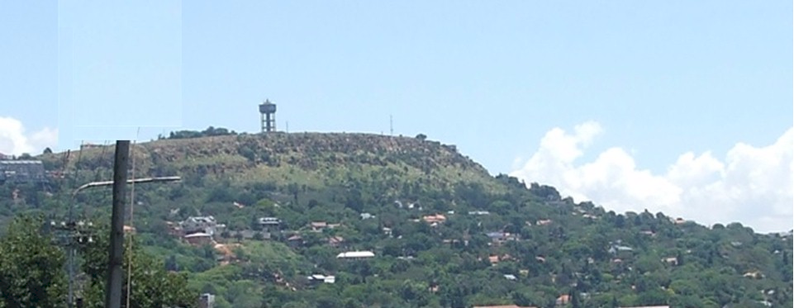

Turning history on its head
Massive evidence of a global flood
What does it all mean?
Part 10 – Summing up
There was a flood!
and there is judgment to come
End Time Issue Ministries
Dr James A Robertson PrEng

Slide 2
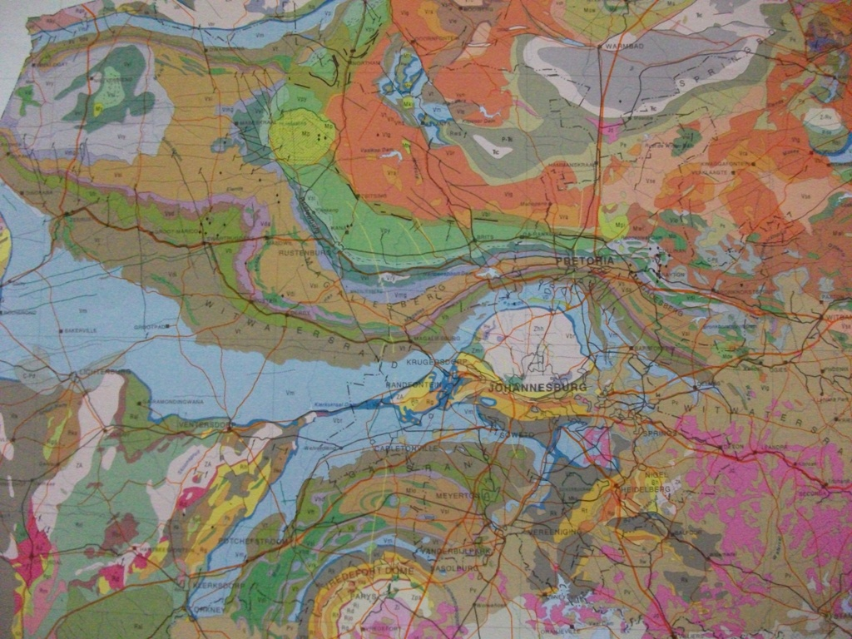
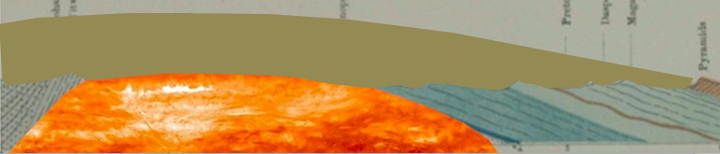
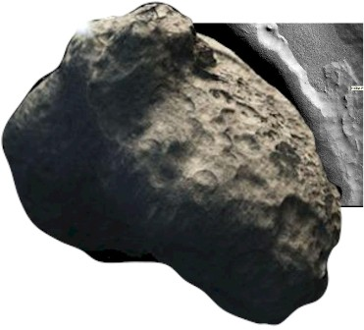
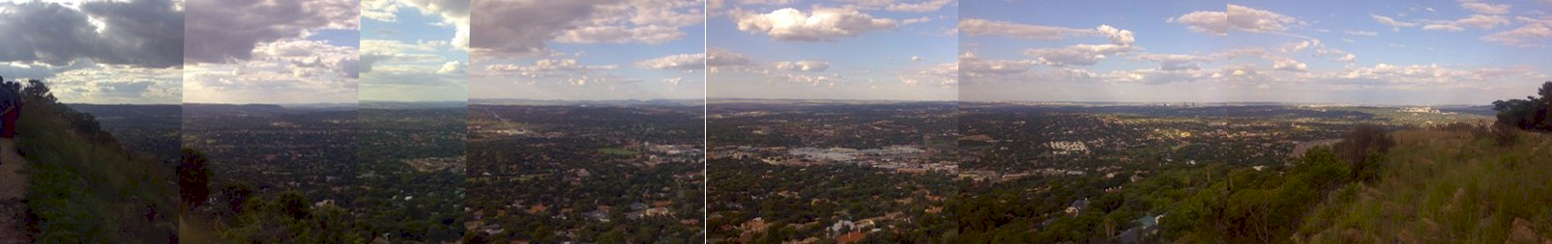
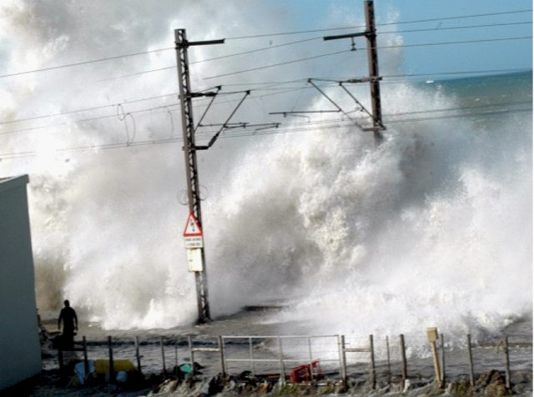
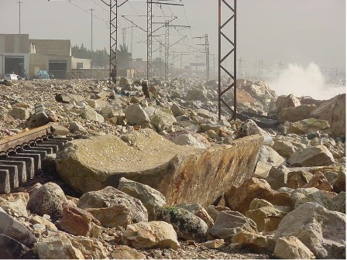
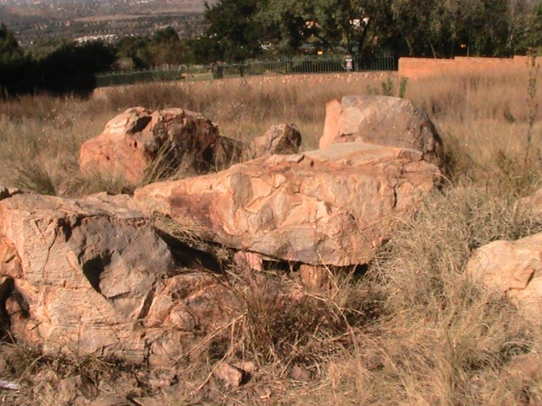
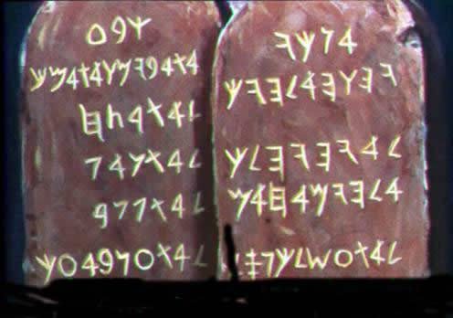

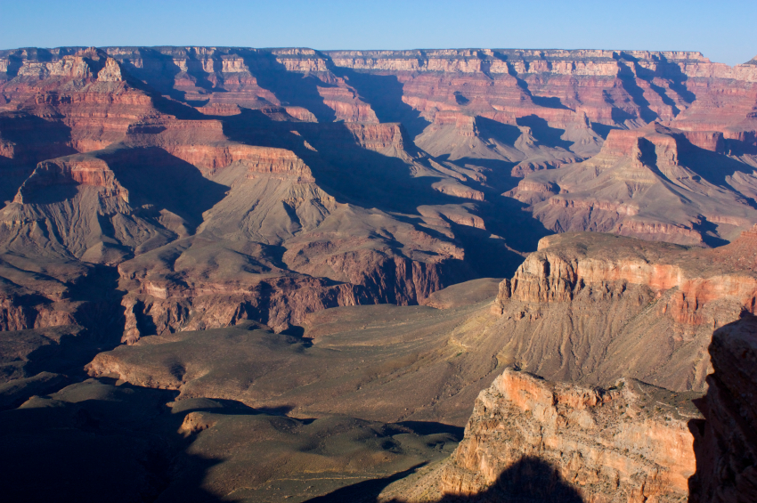
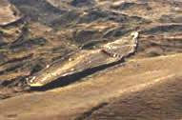


Summing up – The Introduction
Contact me on James@ETIMin.org
Or phone ++27-(0)83-251-6644 or fax ++27-(0)86-540-0178
Notes:
Engineering principle, do NOT extrapolate – engineering characteristics, triaxial and shear tests from PhD – linear portion and then non-linear, erosion bed load – images from article off the web, other graphs that illustrate partly linear and partly non-linear characteristics
If you do extrapolate do so in small increments, test thoroughly in the laboratory and apply a belt and braces approach
It is contrary to fundamental engineering principles to extrapolate from a few centuries or even a few thousand years backwards by thousands, let alone millions let alone billions of years – like a flea at the end of an elephants tail trying to describe its environment
Ant on a railway line taking a view of where Cape Town is or any city 1,000 km away and the route the track follows and ...
Extrapolation – note re Google 1,440 occurences of the quote “extrapolation should be avoided” and 6,180,000 results for extrapolation should be avoided not in quotes, ie all the key words occur on 6 million web pages
Time line to scale cascading magnifying glasses scale of 1 in 1 million and 1 in 1 billion
Railway line to Cape Town to scale of 100 million years relative to recorded human history, cannot take a view of where the line goes when it leaves the station – image of Joburg Station – Google Earth
We must be practical and accept that we cannot extrapolate much beyond the point that we can see backwards in time and we must place heavy reliance on those who lived before us – if there is a book that says there was a global flood about 4,500 years ago and this is corroborated by other books and traditions then we need to give credence to this and not discount it summarily
Dating by radio-carbon or other techniques that assume constant state is fundamentally flawed, if there was a massive event with radioactive impacts some time in the recent past then all theories of dating become entirely invalid
Ask the critical questions and do NOT be fobbed off with academic arguments that make you feel stupid
Do not be fobbed off by “i can show you hundreds / thousands of academics and professionals who will agree with me”
Or “this is waco” as i was told by a good friend some time ago
You are NOT stupid so the explanation for anything should be capable of being intellectually evaluated, understood and accepted or discarded
If you prefix your responce to anything in this presentation with “i do not understand ... (geology, astronomy, geotechnics, physics, etc)” then you are abdicating your intellect, I challenge you to think critically about all that i have to say and show you

Slide 3
Northcliff
A landmark for judgment
Was the topography we see today formed over millions of years?
Or was it the result of a sudden catastrophic event?
How do we explain the mountains and the valleys?
Notes:
Dome, Potato masher, faulting cross section, Randpark Ridge or other dyke, visible fault

Slide 4
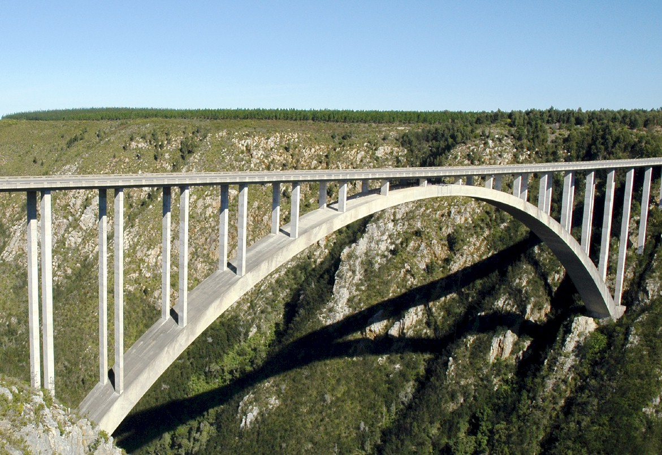
Engineers design bridges NOT to fall down
Notes:
There is a fundamental difference in approach when one designs a bridge NOT TO FALL DOWN
Contrast this with the history paradigm of failed theories and theories that do not stand up to the test of time or engineering reality
In this presentation i am going to challenge a number of theories regarding the age of the earth and the history of the formation of our current geology and topography, i am NOT going to challenge verifiable facts, i AM going to challenge theories that fall down when subject to close scrutiny

Slide 5


A reality check
Historical theory
Notes:
What is not an engineering approach? – Dramatically walk to chair – video clip extract from Dorsa Padideh video – did this ever happen to you? –
WHEN SLEEPING
when i was a child i used to dream that i would stand on a chair and flap my arms and fly around the room --i have to say that that is NOT an engineering approach – as much as i may be convinced i can fly i have to say to you that were i to stand on top of a skyscraper and flap my arms and jump i would hit the ground at great speed and almost certainly die – that is NOT an engineering approach and yet many seem to think they can use software to do things magically – many are hypnotized and mesmerized by IT – are you? CLICK for rabbit out of the hat
We can imagine anything we like about history, whether there was a flood or primevil soup or whatever – what is the truth, there is ONLY one reality about how the surface of this planet came to look the way it does
Find quote on web regarding the formation of the current surface, possibly some sort of diagram

Slide 6

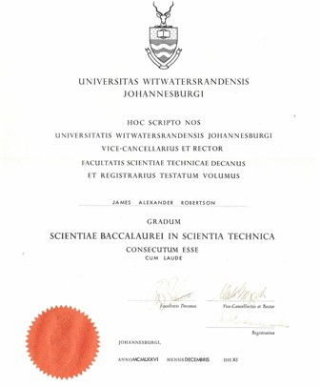

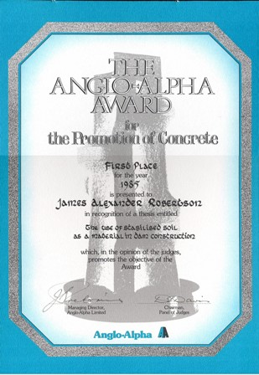
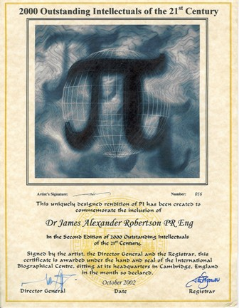
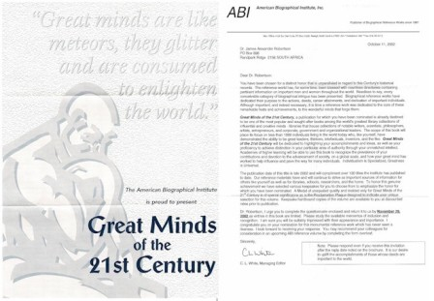
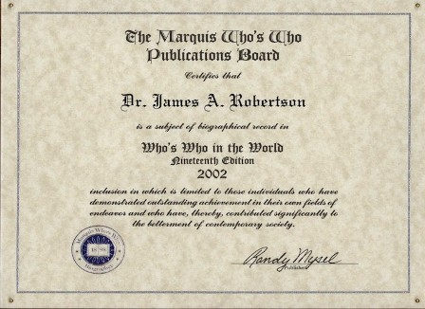
Credentials
Academic and Engineering
End High School 1971 Grade 12 -- distinctions in Maths, Science and Biology
Top Biology student in South Africa National Youth Science Week -- 1971
BSc Engineering (Civil) Cum Laude -- 1976
Doctor of Philosophy Civil Engineering -- 1985
Anglo Alpha award for the Promotion
of Concrete for PhD
2000 Outstanding Intellectuals
Great Minds of the 21st Century
Who’s Who in the World five times
Other accolades
Notes:
JAR nice photo in corner of each credentials slide
Graduation photo in middle of slide with degree certificates and memberships, etc
Matric, BSc, high grades throughout, Science, focus on understanding
Engineering, analysis, IT, economics, engineering principles – images of degrees, Anglo Alpha, PhD graduation, SAICE, SAIMM – all on one page as a collage fade in progressively

Slide 7
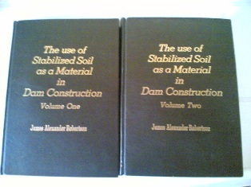
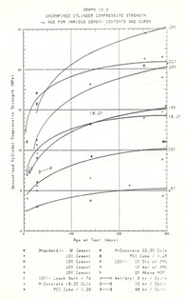
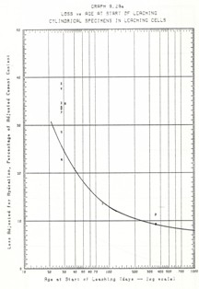
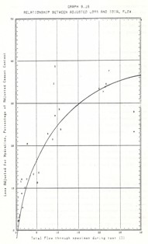
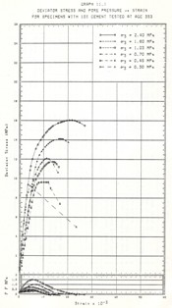
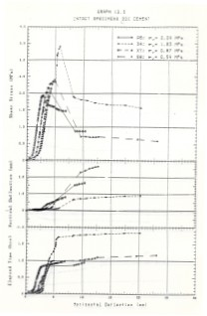
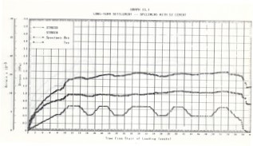
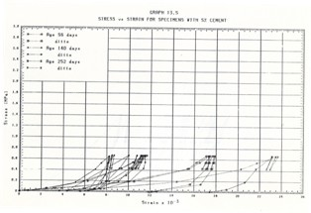
PhD research
Most physical characteristics are non-linear

Slide 8

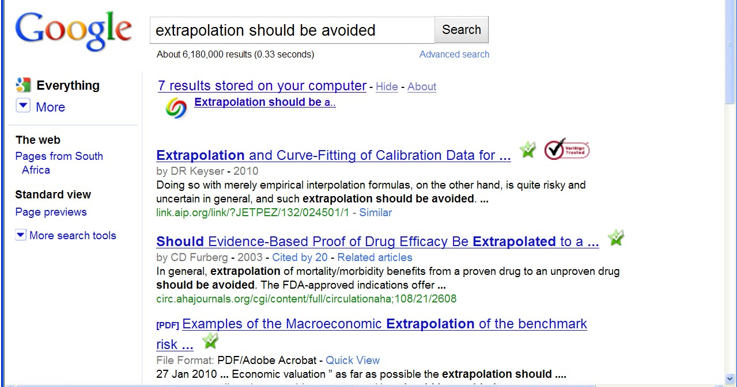
“Extrapolation should be avoided”
A fundamental engineering principle
Only limited increments outside known ranges
Fundamental principle of engineering analysis and design
Google search for words ‘extrapolation should be avoided’ 6,180,000 pages with the words on the same page
965 pages with the exact phrase “extrapolation should be avoided”
Any theory that relies on extrapolation MUST be suspect
All theories relating to the origin of the earth, the age of the earth, the age of geological formations, etc are THEORIES
Examine such theories critically and do NOT suspend your intellect
Notes:
Engineering principle, do NOT extrapolate – engineering characteristics, triaxial and shear tests from PhD – linear portion and then non-linear, erosion bed load – images from article off the web, other graphs that illustrate partly linear and partly non-linear characteristics
If you do extrapolate do so in small increments, test thoroughly in the laboratory and apply a belt and braces approach
It is contrary to fundamental engineering principles to extrapolate from a few centuries or even a few thousand years backwards by thousands, let alone millions let alone billions of years – like a flea at the end of an elephants tail trying to describe its environment
Ant on a railway line taking a view of where Cape Town is or any city 1,000 km away and the route the track follows and ...
Extrapolation – note re Google 1,440 occurences of the quote “extrapolation should be avoided” and 6,180,000 results for extrapolation should be avoided not in quotes, ie all the key words occur on 6 million web pages
Time line to scale cascading magnifying glasses scale of 1 in 1 million and 1 in 1 billion
Railway line to Cape Town to scale of 100 million years relative to recorded human history, cannot take a view of where the line goes when it leaves the station – image of Joburg Station – Google Earth
We must be practical and accept that we cannot extrapolate much beyond the point that we can see backwards in time and we must place heavy reliance on those who lived before us – if there is a book that says there was a global flood about 4,500 years ago and this is corroborated by other books and traditions then we need to give credence to this and not discount it summarily
Dating by radio-carbon or other techniques that assume constant state is fundamentally flawed, if there was a massive event with radioactive impacts some time in the recent past then all theories of dating become entirely invalid
Ask the critical questions and do NOT be fobbed off with academic arguments that make you feel stupid
Do not be fobbed off by “i can show you hundreds / thousands of academics and professionals who will agree with me”
Or “this is waco” as i was told by a good friend some time ago
You are NOT stupid so the explanation for anything should be capable of being intellectually evaluated, understood and accepted or discarded
If you prefix your responce to anything in this presentation with “i do not understand ... (geology, astronomy, geotechnics, physics, etc)” then you are abdicating your intellect, I challenge you to think critically about all that i have to say and show you

Slide 9
Extrapolation over millions or billions of years is invalid
Like an ant on a railway track claiming to know where the train has come from and how long it took and the route it followed
versus
Notes:
Engineering principle, do NOT extrapolate – engineering characteristics, triaxial and shear tests from PhD – linear portion and then non-linear, erosion bed load – images from article off the web, other graphs that illustrate partly linear and partly non-linear characteristics
If you do extrapolate do so in small increments, test thoroughly in the laboratory and apply a belt and braces approach
It is contrary to fundamental engineering principles to extrapolate from a few centuries or even a few thousand years backwards by thousands, let alone millions let alone billions of years – like a flea at the end of an elephants tail trying to describe its environment
Ant on a railway line taking a view of where Cape Town is or any city 1,000 km away and the route the track follows and ...
Extrapolation – note re Google 1,440 occurences of the quote “extrapolation should be avoided” and 6,180,000 results for extrapolation should be avoided not in quotes, ie all the key words occur on 6 million web pages
Time line to scale cascading magnifying glasses scale of 1 in 1 million and 1 in 1 billion
Railway line to Cape Town to scale of 100 million years relative to recorded human history, cannot take a view of where the line goes when it leaves the station – image of Joburg Station – Google Earth
We must be practical and accept that we cannot extrapolate much beyond the point that we can see backwards in time and we must place heavy reliance on those who lived before us – if there is a book that says there was a global flood about 4,500 years ago and this is corroborated by other books and traditions then we need to give credence to this and not discount it summarily
Dating by radio-carbon or other techniques that assume constant state is fundamentally flawed, if there was a massive event with radioactive impacts some time in the recent past then all theories of dating become entirely invalid
Ask the critical questions and do NOT be fobbed off with academic arguments that make you feel stupid
Do not be fobbed off by “i can show you hundreds / thousands of academics and professionals who will agree with me”
Or “this is waco” as i was told by a good friend some time ago
You are NOT stupid so the explanation for anything should be capable of being intellectually evaluated, understood and accepted or discarded
If you prefix your responce to anything in this presentation with “i do not understand ... (geology, astronomy, geotechnics, physics, etc)” then you are abdicating your intellect, I challenge you to think critically about all that i have to say and show you

Slide 10
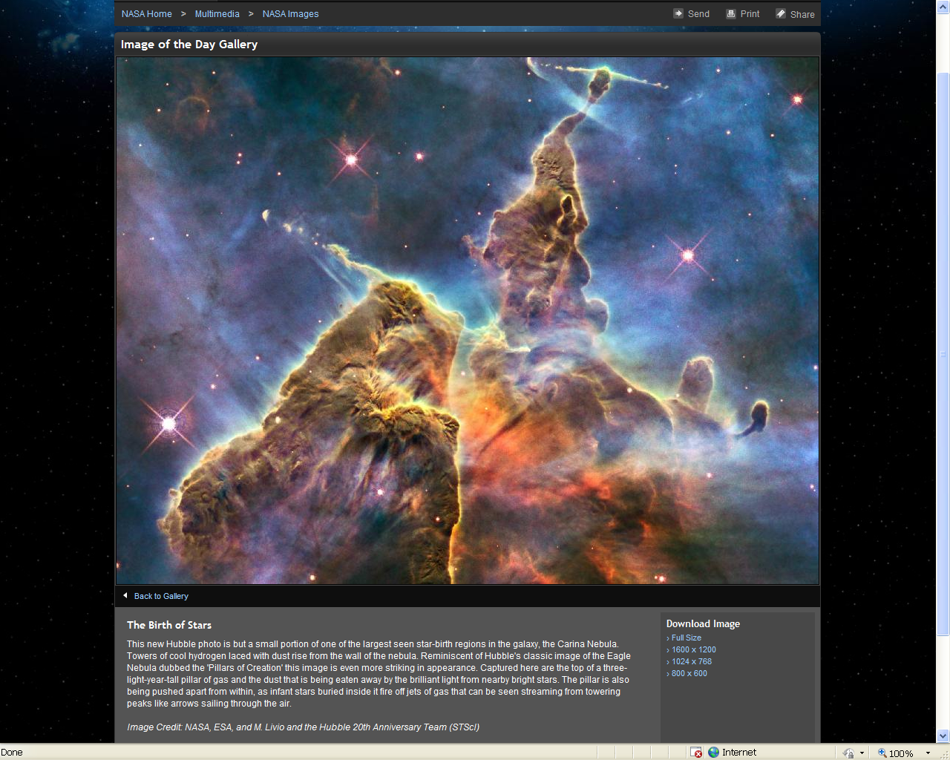
We live in an unstable Universe
Birth of Stars three light year high pillar of gas

Slide 11
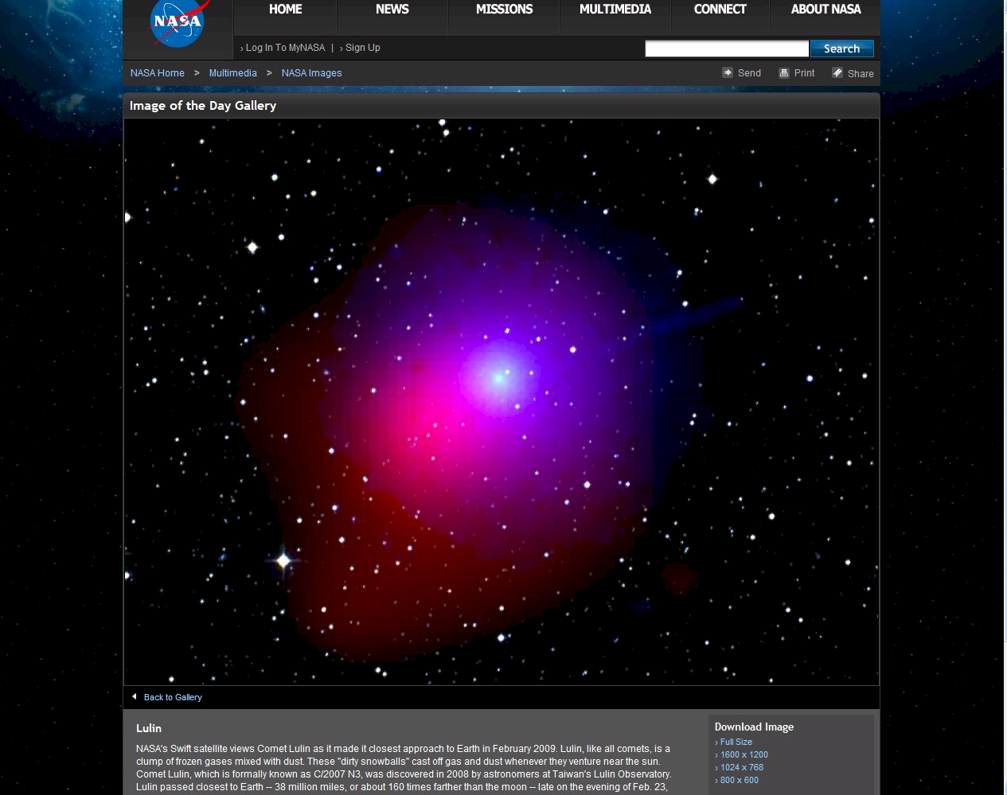
Comet Lulin “dirty snowball” 160 times further than the moon (ie close!)

Slide 12
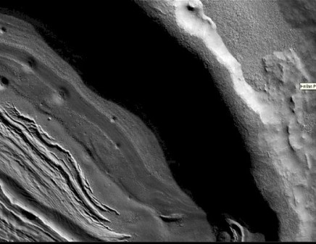
What if ... ?
A massive ice block hit the earth?

Slide 13
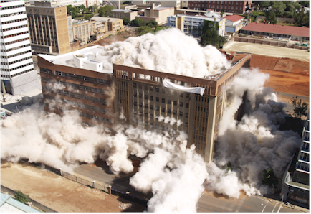
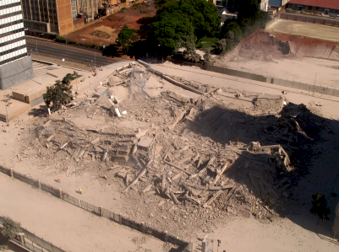
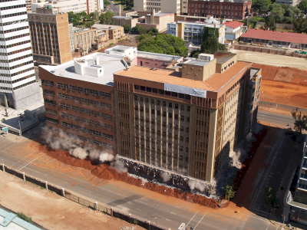
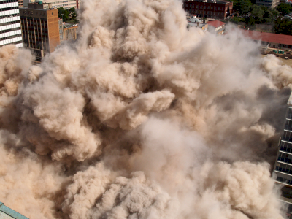
Catastrophic and dramatic change is fast NOT gradual

Slide 14
South African Gold Mines
Notes:
Engineering principle, do NOT extrapolate – engineering characteristics, triaxial and shear tests from PhD – linear portion and then non-linear, erosion bed load – images from article off the web, other graphs that illustrate partly linear and partly non-linear characteristics
If you do extrapolate do so in small increments, test thoroughly in the laboratory and apply a belt and braces approach
It is contrary to fundamental engineering principles to extrapolate from a few centuries or even a few thousand years backwards by thousands, let alone millions let alone billions of years – like a flea at the end of an elephants tail trying to describe its environment
Ant on a railway line taking a view of where Cape Town is or any city 1,000 km away and the route the track follows and ...
Extrapolation – note re Google 1,440 occurences of the quote “extrapolation should be avoided” and 6,180,000 results for extrapolation should be avoided not in quotes, ie all the key words occur on 6 million web pages
Time line to scale cascading magnifying glasses scale of 1 in 1 million and 1 in 1 billion
Railway line to Cape Town to scale of 100 million years relative to recorded human history, cannot take a view of where the line goes when it leaves the station – image of Joburg Station – Google Earth
We must be practical and accept that we cannot extrapolate much beyond the point that we can see backwards in time and we must place heavy reliance on those who lived before us – if there is a book that says there was a global flood about 4,500 years ago and this is corroborated by other books and traditions then we need to give credence to this and not discount it summarily
Dating by radio-carbon or other techniques that assume constant state is fundamentally flawed, if there was a massive event with radioactive impacts some time in the recent past then all theories of dating become entirely invalid
Ask the critical questions and do NOT be fobbed off with academic arguments that make you feel stupid
Do not be fobbed off by “i can show you hundreds / thousands of academics and professionals who will agree with me”
Or “this is waco” as i was told by a good friend some time ago
You are NOT stupid so the explanation for anything should be capable of being intellectually evaluated, understood and accepted or discarded
If you prefix your responce to anything in this presentation with “i do not understand ... (geology, astronomy, geotechnics, physics, etc)” then you are abdicating your intellect, I challenge you to think critically about all that i have to say and show you

Slide 15
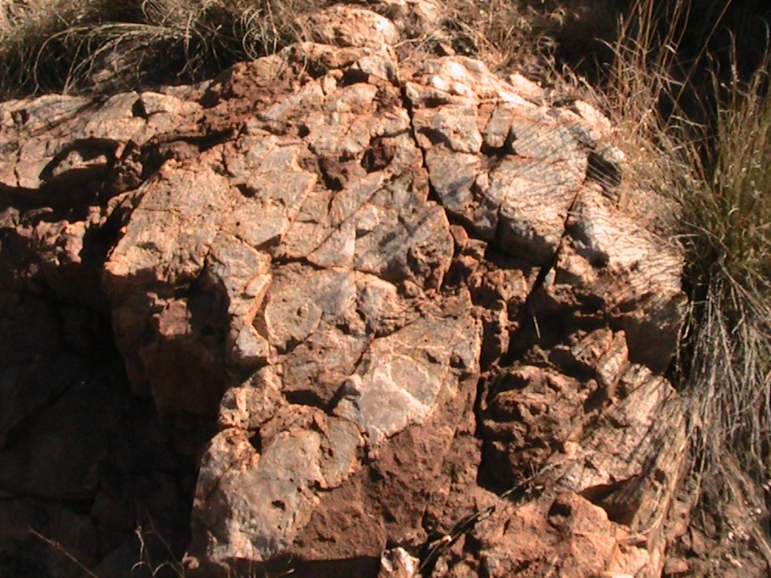
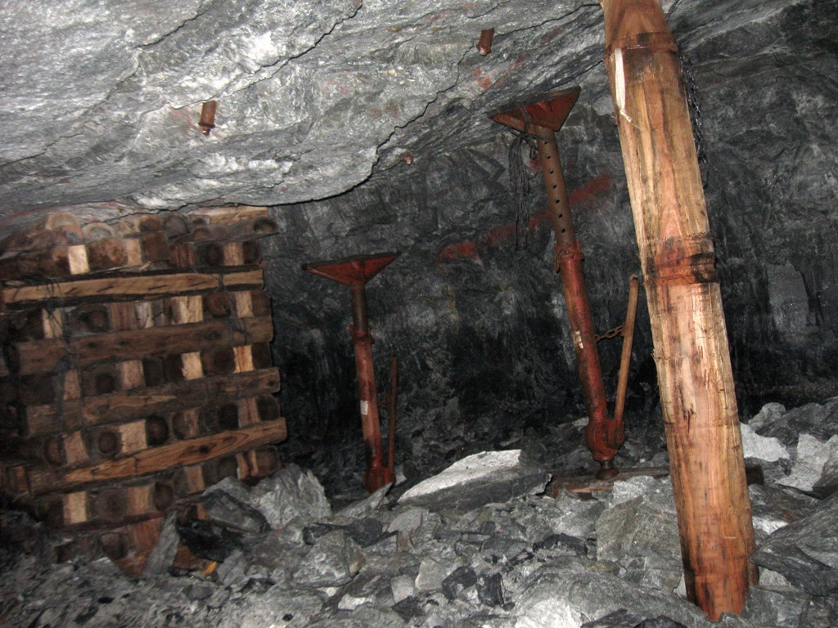
Hard metamorphosed rock
Northcliff – vitrified (ceramic) Quartzite – intense heat and pressure
Gold mine– vitrified (ceramic) Quartzite – intense heat and pressure
Notes:
Very hard rock – same as Northcliff – suggestion of comparable pressure on formation
Metamorphosed
Pressure and heat
Roller compacted concrete dam
Photos from my thesis – samples – creation of artificial rock

Slide 16
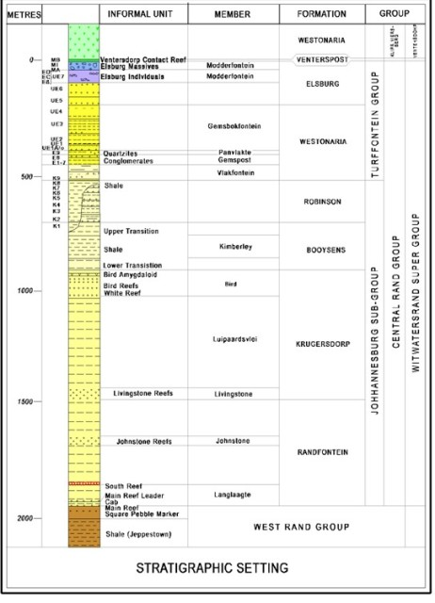

Great depth and extent
Stratigraphic column
Stratigraphic column over 2,000m vertical depth = 7.4 x Hillbrow Tower
i.e. The body of water in which this material was deposited was able to receive the discharge of two (2) kilometers vertical depth of sediment
And there had to be a source of material for two kilometers of deposition
And the deepest mines are close to four (4) kilometers deep, that is over two (2) kilometers BELOW current SEA LEVEL
Notes:
Rough scale drawing – deduce thickness perpendicular to slope from distances on 1:50,000 or find a direct reference to the thickness of the Witwatersrand system – Mark Grave
Stratigraphic column about 2,000 m deep – reaches to below sea level and then the deepest ore body is about 6 km underground, 4 km below sea level and the deepest mine is close to 4 km deep, about 2,000 m below sea level
Diagram

Slide 17
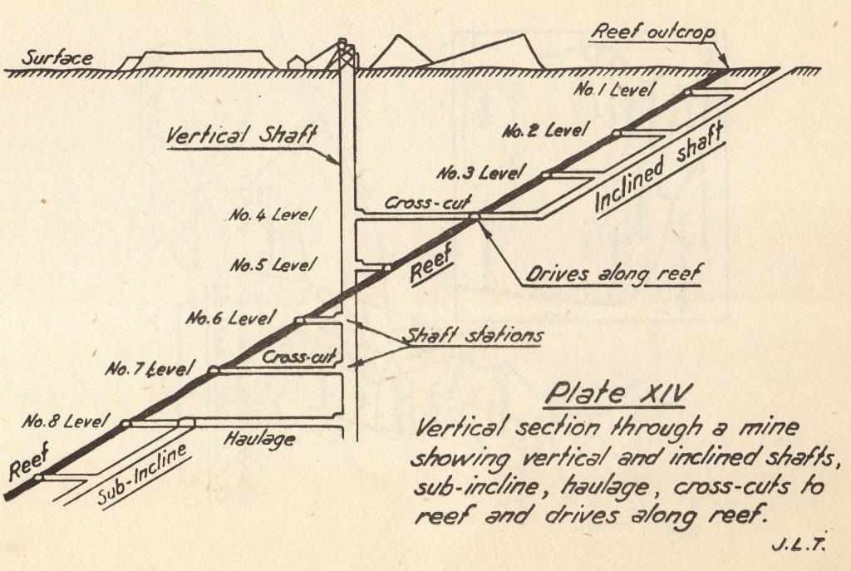
Dipping at about 30 degrees
Horizontally deposited under water but now dipping about thirty degrees
How did this
Happen?
Notes:
Horizontally deposited under water but now dipping at about 30 degrees to the South and the West with Northcliff as a pivot point relative to the mines in the East and South and those on the West
Vertical section through a shaft showing dip, tunnels, drives, etc

Slide 18
Highly complex geology
Notes:
Same formation as Northcliff and the Magaliesberg – photos of both
Great extent, map of gold fields
Collage of headgears

Slide 19
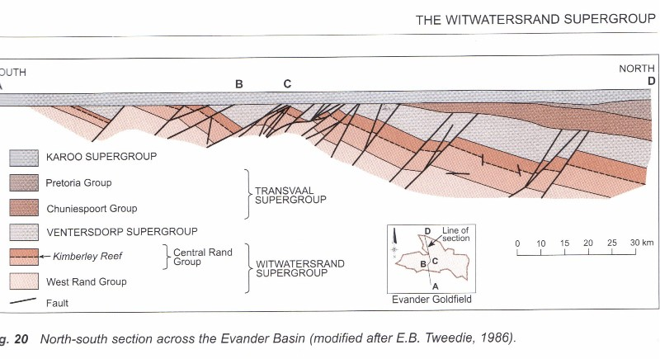
Highly faulted
Top cut off level
Horizontal deposits on top
Notes:
Faulting to great depth
Deepest shafts to / planned to over 5 km under ground, 3 km below sea level
Show tallest building in Johannesburg and tallest in the world stacked against depth of 5 km
Massive faulting, blocks moved
Dip varies,
Depth varies
Sections from Geology of South Africa and other sources
Johannesburg Graben – dolerite dyke

Slide 20
Sedimentary (water laid) rocks
Notes:
Engineering principle, do NOT extrapolate – engineering characteristics, triaxial and shear tests from PhD – linear portion and then non-linear, erosion bed load – images from article off the web, other graphs that illustrate partly linear and partly non-linear characteristics
If you do extrapolate do so in small increments, test thoroughly in the laboratory and apply a belt and braces approach
It is contrary to fundamental engineering principles to extrapolate from a few centuries or even a few thousand years backwards by thousands, let alone millions let alone billions of years – like a flea at the end of an elephants tail trying to describe its environment
Ant on a railway line taking a view of where Cape Town is or any city 1,000 km away and the route the track follows and ...
Extrapolation – note re Google 1,440 occurences of the quote “extrapolation should be avoided” and 6,180,000 results for extrapolation should be avoided not in quotes, ie all the key words occur on 6 million web pages
Time line to scale cascading magnifying glasses scale of 1 in 1 million and 1 in 1 billion
Railway line to Cape Town to scale of 100 million years relative to recorded human history, cannot take a view of where the line goes when it leaves the station – image of Joburg Station – Google Earth
We must be practical and accept that we cannot extrapolate much beyond the point that we can see backwards in time and we must place heavy reliance on those who lived before us – if there is a book that says there was a global flood about 4,500 years ago and this is corroborated by other books and traditions then we need to give credence to this and not discount it summarily
Dating by radio-carbon or other techniques that assume constant state is fundamentally flawed, if there was a massive event with radioactive impacts some time in the recent past then all theories of dating become entirely invalid
Ask the critical questions and do NOT be fobbed off with academic arguments that make you feel stupid
Do not be fobbed off by “i can show you hundreds / thousands of academics and professionals who will agree with me”
Or “this is waco” as i was told by a good friend some time ago
You are NOT stupid so the explanation for anything should be capable of being intellectually evaluated, understood and accepted or discarded
If you prefix your responce to anything in this presentation with “i do not understand ... (geology, astronomy, geotechnics, physics, etc)” then you are abdicating your intellect, I challenge you to think critically about all that i have to say and show you

Slide 21
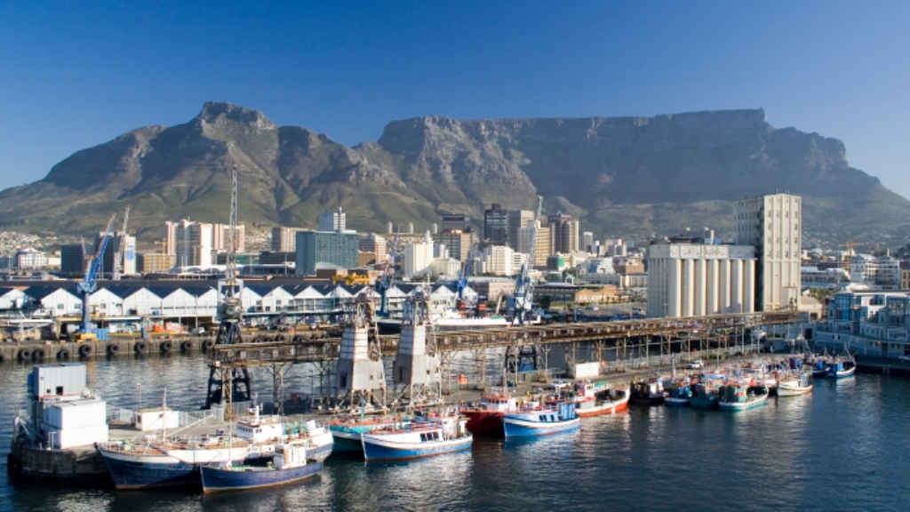
Throughout South Africa
Table Mountain – Cape Town

Slide 22
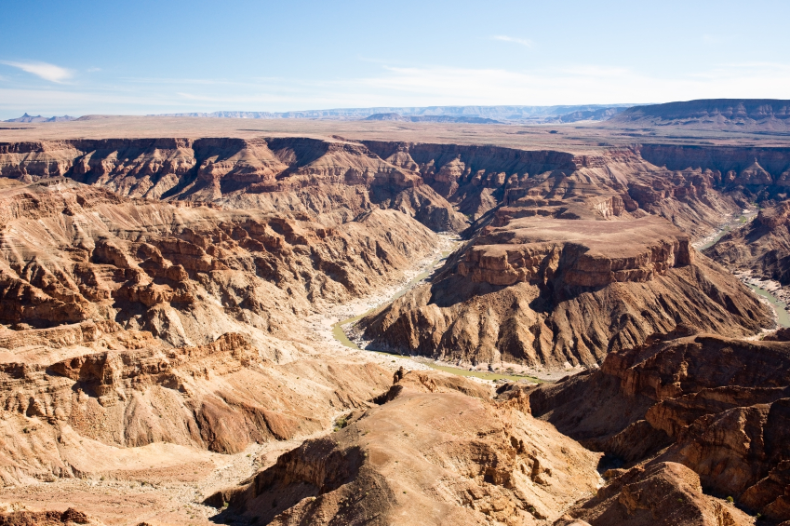
Throughout South Africa
Fish River Canyon
Namibia

Slide 23
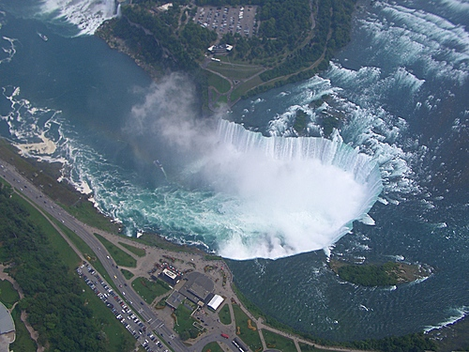
All over the World
Niagara Falls – USA - Canada
Notes:
Then explode up to Fish River, Grand Canyon, Ayers Rock, USA, Spain, etc, etc montage around the world
Look for references to frequency of occurence of sedimentary rocks around the world

Slide 24
All over the World
Grand Canyon -- USA
Notes:
Then explode up to Fish River, Grand Canyon, Ayers Rock, USA, Spain, etc, etc montage around the world
Look for references to frequency of occurence of sedimentary rocks around the world

Slide 25
Massive wave action can move huge volumes of material very rapidly
Notes:
Different degrees of metamorphosis – Swartruggens sandstone -- pressure and no heat, Northcliff quartzite – pressure AND heat
KOV, Nchanga, Phalaborwa, etc

Slide 26
Halfway House Granite Dome
Notes:
Engineering principle, do NOT extrapolate – engineering characteristics, triaxial and shear tests from PhD – linear portion and then non-linear, erosion bed load – images from article off the web, other graphs that illustrate partly linear and partly non-linear characteristics
If you do extrapolate do so in small increments, test thoroughly in the laboratory and apply a belt and braces approach
It is contrary to fundamental engineering principles to extrapolate from a few centuries or even a few thousand years backwards by thousands, let alone millions let alone billions of years – like a flea at the end of an elephants tail trying to describe its environment
Ant on a railway line taking a view of where Cape Town is or any city 1,000 km away and the route the track follows and ...
Extrapolation – note re Google 1,440 occurences of the quote “extrapolation should be avoided” and 6,180,000 results for extrapolation should be avoided not in quotes, ie all the key words occur on 6 million web pages
Time line to scale cascading magnifying glasses scale of 1 in 1 million and 1 in 1 billion
Railway line to Cape Town to scale of 100 million years relative to recorded human history, cannot take a view of where the line goes when it leaves the station – image of Joburg Station – Google Earth
We must be practical and accept that we cannot extrapolate much beyond the point that we can see backwards in time and we must place heavy reliance on those who lived before us – if there is a book that says there was a global flood about 4,500 years ago and this is corroborated by other books and traditions then we need to give credence to this and not discount it summarily
Dating by radio-carbon or other techniques that assume constant state is fundamentally flawed, if there was a massive event with radioactive impacts some time in the recent past then all theories of dating become entirely invalid
Ask the critical questions and do NOT be fobbed off with academic arguments that make you feel stupid
Do not be fobbed off by “i can show you hundreds / thousands of academics and professionals who will agree with me”
Or “this is waco” as i was told by a good friend some time ago
You are NOT stupid so the explanation for anything should be capable of being intellectually evaluated, understood and accepted or discarded
If you prefix your responce to anything in this presentation with “i do not understand ... (geology, astronomy, geotechnics, physics, etc)” then you are abdicating your intellect, I challenge you to think critically about all that i have to say and show you

Slide 27
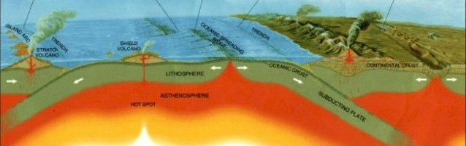

The earth has a molten rock core
Notes:
Small domes in lowveld
Images from paper on deep drill hole in Germany other domes from iStock

Slide 28
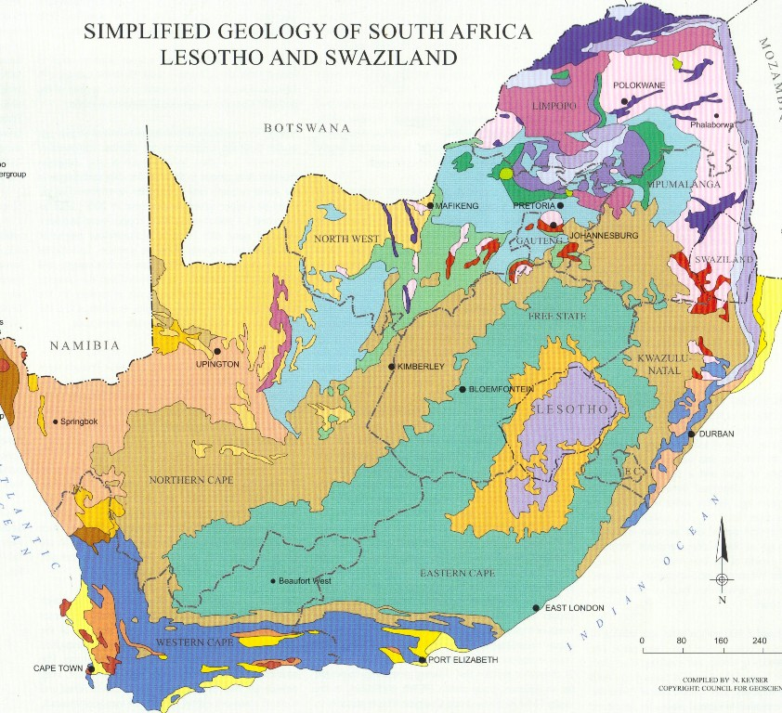
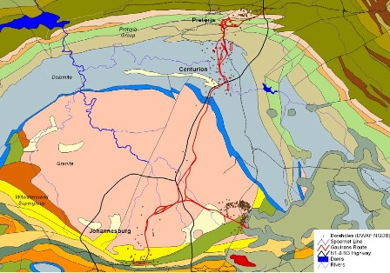
What is a dome?
A massive granite intrusion
Halfway House Granite Dome
Notes:
Small domes in lowveld
Images from paper on deep drill hole in Germany other domes from iStock

Slide 29
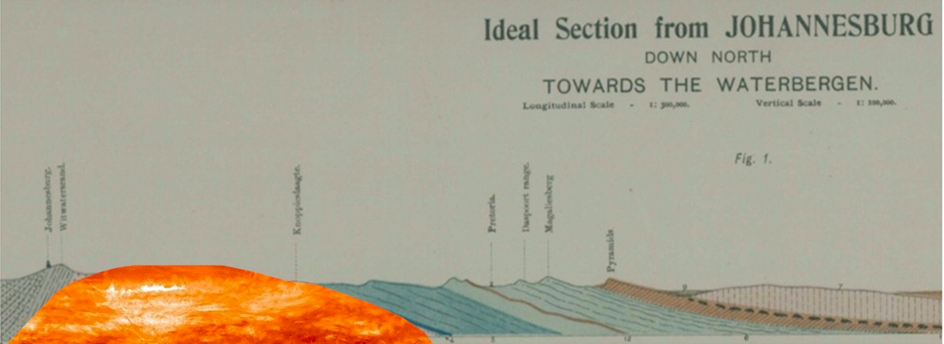
What is a dome?
Upthrust of molten rock through a weak zone in the earth’s crust
Forces up horizontally bedded rocks in an arch over the intrusion
Bakes them as in a furnace and converts to semi-vitreous (ceramic) quartzite, etc – extremely hard rock
Notes:
Small domes in lowveld
Images from paper on deep drill hole in Germany other domes from iStock

Slide 30

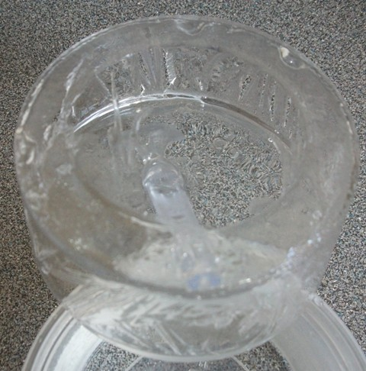
A thin crust
Implies a thin crust at the time
Cooling and solidifying from the outside inwards
Notes:
How is this possible?
The crust is reportedly 40 to 60 km thick?
What if earth core is cooling rapidly?
Thin crust
Ice photo’ becomes solid from outside in
What if as it cools it contracts and puts pressure on the core and the core has to force its way out?

Slide 31
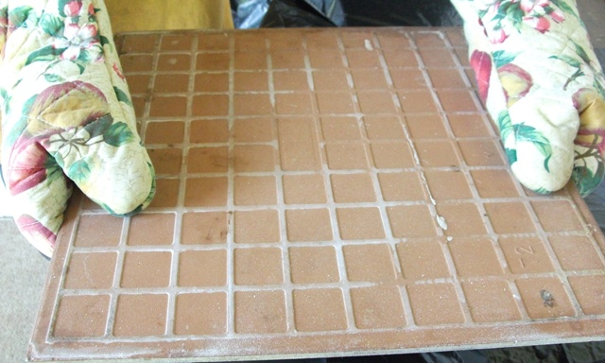
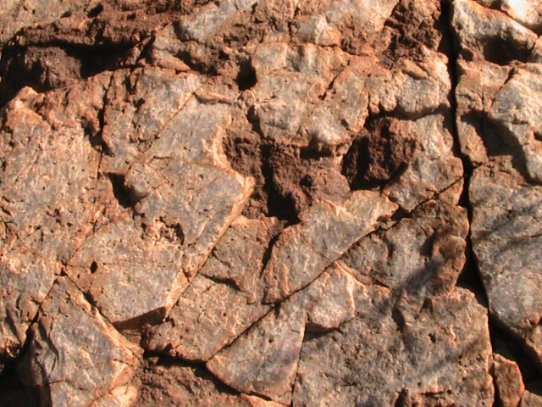
Quartzite – evidence of intense heat
Notes:
Photo’s and videos breaking ice, not breaking ice, breaking tile, show how tile is hard ceramic like rock on Northcliff – close up of both
Kerfed would and not kerfed wood
The rock is NOT cracked open and kerfed as would be the case if it was hard when the dome thrust up, it is conformed to the dome like the window putty and then baked to vitreous rock

Slide 32

The rock was NOT rock at the time soft, newly deposited sand and mud would CONFORM to the intrusion
Notes:
Photo’s and videos breaking ice, not breaking ice, breaking tile, show how tile is hard ceramic like rock on Northcliff – close up of both
Kerfed would and not kerfed wood
The rock is NOT cracked open and kerfed as would be the case if it was hard when the dome thrust up, it is conformed to the dome like the window putty and then baked to vitreous rock

Slide 33
African Erosion Surface
Notes:
Engineering principle, do NOT extrapolate – engineering characteristics, triaxial and shear tests from PhD – linear portion and then non-linear, erosion bed load – images from article off the web, other graphs that illustrate partly linear and partly non-linear characteristics
If you do extrapolate do so in small increments, test thoroughly in the laboratory and apply a belt and braces approach
It is contrary to fundamental engineering principles to extrapolate from a few centuries or even a few thousand years backwards by thousands, let alone millions let alone billions of years – like a flea at the end of an elephants tail trying to describe its environment
Ant on a railway line taking a view of where Cape Town is or any city 1,000 km away and the route the track follows and ...
Extrapolation – note re Google 1,440 occurences of the quote “extrapolation should be avoided” and 6,180,000 results for extrapolation should be avoided not in quotes, ie all the key words occur on 6 million web pages
Time line to scale cascading magnifying glasses scale of 1 in 1 million and 1 in 1 billion
Railway line to Cape Town to scale of 100 million years relative to recorded human history, cannot take a view of where the line goes when it leaves the station – image of Joburg Station – Google Earth
We must be practical and accept that we cannot extrapolate much beyond the point that we can see backwards in time and we must place heavy reliance on those who lived before us – if there is a book that says there was a global flood about 4,500 years ago and this is corroborated by other books and traditions then we need to give credence to this and not discount it summarily
Dating by radio-carbon or other techniques that assume constant state is fundamentally flawed, if there was a massive event with radioactive impacts some time in the recent past then all theories of dating become entirely invalid
Ask the critical questions and do NOT be fobbed off with academic arguments that make you feel stupid
Do not be fobbed off by “i can show you hundreds / thousands of academics and professionals who will agree with me”
Or “this is waco” as i was told by a good friend some time ago
You are NOT stupid so the explanation for anything should be capable of being intellectually evaluated, understood and accepted or discarded
If you prefix your responce to anything in this presentation with “i do not understand ... (geology, astronomy, geotechnics, physics, etc)” then you are abdicating your intellect, I challenge you to think critically about all that i have to say and show you

Slide 34
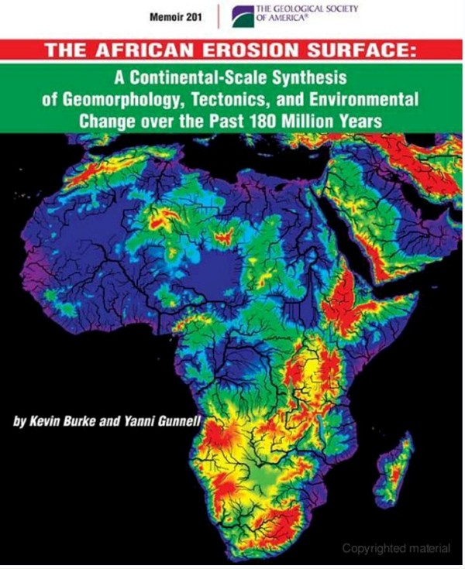
The African Erosion Surface
A massive flat plane
Notes:
Refer to map in paper off the Internet
Map from my Atlas – scan
Map of Johannesburg / Gauteng – not too detailed
Panorama’s
Northcliff, Voortrekker Monument, Grand Central Airport?, Primrose, Kraft Road, Koster, Swartruggens
Rotate each panorama to level view
Rotate till level??
Put a Spirit level on the image

Slide 35

Panorama North from Northcliff
West
North
East
Almost exactly uniform and level horizon
Same panorama characteristics all over the Witwatersrand, Gauteng and beyond
Notes:
Refer to map in paper off the Internet
Map from my Atlas – scan
Map of Johannesburg / Gauteng – not too detailed
Panorama’s
Northcliff, Voortrekker Monument, Grand Central Airport?, Primrose, Kraft Road, Koster, Swartruggens
Rotate each panorama to level view
Rotate till level??
Put a Spirit level on the image

Slide 36
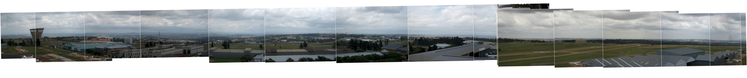

Panorama from Grand Central Airport Control Tower
South
West
North
East
South
Image shows curvature of the earth
No high points above the uniform level line on the horizon
Notes:
Refer to map in paper off the Internet
Map from my Atlas – scan
Map of Johannesburg / Gauteng – not too detailed
Panorama’s
Northcliff, Voortrekker Monument, Grand Central Airport?, Primrose, Kraft Road, Koster, Swartruggens
Rotate each panorama to level view
Rotate till level??
Put a Spirit level on the image

Slide 37

Spot heights on maps
High point variation of 100 m (5%) over 100 km – a feat of engineering
1852
1652
1807
1689
1736
1809
1902

Slide 38








The art of plane and level
Our manmade world is precise
Level and plum all over
Buildings
Cakes (sometimes)
Furniture
Requires specialist tools and machines
Long span relative to the size of the bumps to be removed
Notes:
Laying concrete – slab on William Nicol
Spirit level
Road grader
View of my garden
We take flat and level for granted
Difficult to create
Cake

Slide 39


So how did the African Erosion Surface get to be so level?
Tsunami?
Notes:
What force could plane these rocks off so level over such a wide area?
Something that applies a uniform shearing / cutting force over a wide area on a consistent enough basis to achieve this high level of uniformity with such massive removal of material?
A global tidal wave ripping round the planet repeatedly as the earth rotated, cutting down layer after layer?
What about a Tsunami?

Slide 40
Incised Valleys
Notes:
Engineering principle, do NOT extrapolate – engineering characteristics, triaxial and shear tests from PhD – linear portion and then non-linear, erosion bed load – images from article off the web, other graphs that illustrate partly linear and partly non-linear characteristics
If you do extrapolate do so in small increments, test thoroughly in the laboratory and apply a belt and braces approach
It is contrary to fundamental engineering principles to extrapolate from a few centuries or even a few thousand years backwards by thousands, let alone millions let alone billions of years – like a flea at the end of an elephants tail trying to describe its environment
Ant on a railway line taking a view of where Cape Town is or any city 1,000 km away and the route the track follows and ...
Extrapolation – note re Google 1,440 occurences of the quote “extrapolation should be avoided” and 6,180,000 results for extrapolation should be avoided not in quotes, ie all the key words occur on 6 million web pages
Time line to scale cascading magnifying glasses scale of 1 in 1 million and 1 in 1 billion
Railway line to Cape Town to scale of 100 million years relative to recorded human history, cannot take a view of where the line goes when it leaves the station – image of Joburg Station – Google Earth
We must be practical and accept that we cannot extrapolate much beyond the point that we can see backwards in time and we must place heavy reliance on those who lived before us – if there is a book that says there was a global flood about 4,500 years ago and this is corroborated by other books and traditions then we need to give credence to this and not discount it summarily
Dating by radio-carbon or other techniques that assume constant state is fundamentally flawed, if there was a massive event with radioactive impacts some time in the recent past then all theories of dating become entirely invalid
Ask the critical questions and do NOT be fobbed off with academic arguments that make you feel stupid
Do not be fobbed off by “i can show you hundreds / thousands of academics and professionals who will agree with me”
Or “this is waco” as i was told by a good friend some time ago
You are NOT stupid so the explanation for anything should be capable of being intellectually evaluated, understood and accepted or discarded
If you prefix your responce to anything in this presentation with “i do not understand ... (geology, astronomy, geotechnics, physics, etc)” then you are abdicating your intellect, I challenge you to think critically about all that i have to say and show you

Slide 41


What the remaining surface of the dome actually evidences
Dome
Digital Terrain Model
Courtesy of Paul Wilson
Sales Manager of ComputaMaps
Tel: +27 21 700 8140 (8145 direct line)
Fax: +27 21 701 9520
Skype ID: computamaps-rsa
email: pwilson@computamaps.com
Website: http://www.computamaps.com
Private Bag X20, Constantia, 7848, South Africa
Notice how the ground has been removed between the high points
Notes:
View from Northcliff or somewhere else where the incision is particularly noticeable and clear
View from within a valley, on the road somewhere, maybe near Fritz?

Slide 42


Little streams with flat valleys
The streams could never erode valleys like these, the erosive capacity is far too low, even in flood
Notes:
Craighall, Fritz

Slide 43


Gentle rain does NOTHING it is all about high velocity water
High velocity water erodes rapidly and continues eroding until there is nothing left to erode
Notes:
Garden sprinkler
Hose at different pressures
May need to shoot a new bit of video for hose scouring away material
Velocity versus bed load from paper from web

Slide 44


Plucked cliff faces
Northcliff
Hartebeespoort (Magaliesberg)
Rocks have been plucked out of sheer cliff faces
Notes:
Various cliff faces and hill tops – large boulders standing free, how did they get left behind, where has the material around them gone
Top of Table Mountain
Clean, sharp edges

Slide 45

Plucked hill tops
Northcliff
Large rocks plucked out of the TOPS of hills
NOT gentle erosion by rain
Boiling water with massive tsunamis?
Gordon Road
Notes:
Various cliff faces and hill tops – large boulders standing free, how did they get left behind, where has the material around them gone
Top of Table Mountain
Clean, sharp edges

Slide 46


Where has all the rock gone?
River flow
All this distance
All through this one gorge
Notes:
Flash back to cut out from Northcliff, rough estimate of volume say 50km radius, 100 m deep gives approximately 2,000 km squared and nearly 200 cubic kilometers of material, that is 200,000,000,000 cubic meters of material that has disappeared down hill potentially first stop Eastern Limpopo and possibly the Mozambique Channel – find a suitable map – atlas?
Bigger problem with the Drakensberg whether eastern Mapumalanga and Limpopo or Kwa Zulu Natal and also with Table Mountain and, and, and

Slide 47


Erosion of valleys
Limited bedload = narrow valley
Large bedload = wide flat valley
Notes:
Flash back to cut out from Northcliff, rough estimate of volume say 50km radius, 100 m deep gives approximately 2,000 km squared and nearly 200 cubic kilometers of material, that is 200,000,000,000 cubic meters of material that has disappeared down hill potentially first stop Eastern Limpopo and possibly the Mozambique Channel – find a suitable map – atlas?
Bigger problem with the Drakensberg whether eastern Mapumalanga and Limpopo or Kwa Zulu Natal and also with Table Mountain and, and, and

Slide 48
A huge problem to explain
The rock was not removed by ice
It did not evaporate
It did not dissolve
It can only have been
eroded by massive
water suction resulting
from high velocity
Coupled with boiling water?
How could this happen?
Notes:
If the rock was indeed washed into the Mozambique Channel we have another problem -- where did the Mozambique Channel come from?
And the Mariana Trench?
Huge holes into which huge volumes of material have seeming disappeared?
And where did the water come from and where did it go?

Slide 49

Continental separation
The continents fit together
Conventional theory says this took place gradually over millions of years
What if it happened rapidly like all the other events discussed in this presentation?
Notes:
If the rock was indeed washed into the Mozambique Channel we have another problem -- where did the Mozambique Channel come from?
And the Mariana Trench?
Huge holes into which huge volumes of material have seeming disappeared?
And where did the water come from and where did it go?

Slide 50


Continental separation
Hypothesis for splitting / cracking
Coefficient of thermal expansion:
Granite 6.5 micrometers per meter at 20 degrees Centigrade
Melting point of Granite = 1,700 degrees Centigrade
Cooling from molten to zero degrees would shrink the
circumference of the earth by approximately 427 km
BUT the core would NOT shrink
Massive tension and splitting of the crust would result
Notes:
If the rock was indeed washed into the Mozambique Channel we have another problem -- where did the Mozambique Channel come from?
And the Mariana Trench?
Huge holes into which huge volumes of material have seeming disappeared?
And where did the water come from and where did it go?

Slide 51







Continental separation and water drainage
As continents separate massive gorges form
Water rushes off
the continents
Massive erosion beyond anything we can visualize occurs
Notes:
If the rock was indeed washed into the Mozambique Channel we have another problem -- where did the Mozambique Channel come from?
And the Mariana Trench?
Huge holes into which huge volumes of material have seeming disappeared?
And where did the water come from and where did it go?

Slide 52


Ocean trenches
Another source of drainage
The Mariana Trench is 11,000 m deep
Seemingly concurrently with continental separation trenches were also formed further draining water off the continents
The volume of the seas is MUCH greater than the volume of the continents
Easy to postulate rapid and dramatic drainage
Notes:
If the rock was indeed washed into the Mozambique Channel we have another problem -- where did the Mozambique Channel come from?
And the Mariana Trench?
Huge holes into which huge volumes of material have seeming disappeared?
And where did the water come from and where did it go?

Slide 53


Continental separation
Hypothesis for displacement
Fly-by of large space object
Theories that earth’s axis was once
vertical
That orbit of sun was not elliptical
That a year was exactly 360 days
A large comet or other space object
that exerted massive gravitational
pull on the earth could pull the earth
out of a circular orbit around the sun
AND cause the earth to tilt on its axis, one theory says close to 30 degrees originally
WHY NOT?
Notes:
If the rock was indeed washed into the Mozambique Channel we have another problem -- where did the Mozambique Channel come from?
And the Mariana Trench?
Huge holes into which huge volumes of material have seeming disappeared?
And where did the water come from and where did it go?

Slide 54
The age of all this?
Notes:
Engineering principle, do NOT extrapolate – engineering characteristics, triaxial and shear tests from PhD – linear portion and then non-linear, erosion bed load – images from article off the web, other graphs that illustrate partly linear and partly non-linear characteristics
If you do extrapolate do so in small increments, test thoroughly in the laboratory and apply a belt and braces approach
It is contrary to fundamental engineering principles to extrapolate from a few centuries or even a few thousand years backwards by thousands, let alone millions let alone billions of years – like a flea at the end of an elephants tail trying to describe its environment
Ant on a railway line taking a view of where Cape Town is or any city 1,000 km away and the route the track follows and ...
Extrapolation – note re Google 1,440 occurences of the quote “extrapolation should be avoided” and 6,180,000 results for extrapolation should be avoided not in quotes, ie all the key words occur on 6 million web pages
Time line to scale cascading magnifying glasses scale of 1 in 1 million and 1 in 1 billion
Railway line to Cape Town to scale of 100 million years relative to recorded human history, cannot take a view of where the line goes when it leaves the station – image of Joburg Station – Google Earth
We must be practical and accept that we cannot extrapolate much beyond the point that we can see backwards in time and we must place heavy reliance on those who lived before us – if there is a book that says there was a global flood about 4,500 years ago and this is corroborated by other books and traditions then we need to give credence to this and not discount it summarily
Dating by radio-carbon or other techniques that assume constant state is fundamentally flawed, if there was a massive event with radioactive impacts some time in the recent past then all theories of dating become entirely invalid
Ask the critical questions and do NOT be fobbed off with academic arguments that make you feel stupid
Do not be fobbed off by “i can show you hundreds / thousands of academics and professionals who will agree with me”
Or “this is waco” as i was told by a good friend some time ago
You are NOT stupid so the explanation for anything should be capable of being intellectually evaluated, understood and accepted or discarded
If you prefix your responce to anything in this presentation with “i do not understand ... (geology, astronomy, geotechnics, physics, etc)” then you are abdicating your intellect, I challenge you to think critically about all that i have to say and show you

Slide 55

The dilemma of the “God’s Word” phenomenon
The Bible is the word of God and without error
The Bible says there was a flood
I believe the Bible
So that settles it!
THERE WAS A FLOOD!
But nowhere in the book (Greek biblios = book) does the bible claim to be without error or to be “the Word of God”
It IS a book containing a collection of historical records
Notes:
Engineering practice prohibits material extrapolation – search on the Net for a quote
All historical theories about the age of the earth, evolution that rely on millions of years steady state radioactivity, etc are at best fatally flawed and at worst utter foolishness

Slide 56
The dilemma of the “my teacher told me” phenomenon
Professor ... told me
There was NO flood
This planet came into existence 4.55 billion years ago plus or minus 1%
Everything happened gradually
There is nothing to discuss
But we have no way of knowing what happened millions of years ago
It is pure speculation
We must look at current practical facts
Notes:
Engineering practice prohibits material extrapolation – search on the Net for a quote
All historical theories about the age of the earth, evolution that rely on millions of years steady state radioactivity, etc are at best fatally flawed and at worst utter foolishness

Slide 57
The problem of clean sharp corners
All over the world we find clean rocks with sharp corners
Over millions or billions of years these corners would be weathered and rounded by thermal stressing and covered with moss and lichen
Millions of years is
improbable
Are there other indicators
of age?
Notes:
Remember the clean, sharp corners of the rocks
Northcliff, Swartruggens, Victoria Falls, etc – no evidence of millions of years of wear and rounding
Granite in the valleys of Johannesburg
No lichen, no heat rounding, no rain rounding, clean sharp corners

Slide 58
Noah’s Ship (Ark) found (about 2345BC)
Genesis 7:11-12 “In the six hundredth year of Noah's life, in the second month, the seventeenth day of the month, on that day all the fountains of the great deep were broken up, and the windows of heaven were opened. And the rain was on the earth forty days and forty nights.” NKJV
Genesis 8:3-4 “And the waters receded continually from the earth. At the end of the hundred and fifty days the waters decreased. Then the ark rested in the seventh month, the seventeenth day of the month, on the mountains of Ararat.” NKJV
Remains of a huge wooden vessel submerged in a volcanic mudflow found in the mountains of Ararat in Turkey
Size agrees with Genesis 6:15 length 150 meters, width 25 meters and height 15 meters
Notes:
Quote from Genesis about the flood – also later quotes?
Incidentally, the boat (Ark meaning container) has been found – artists impression of Ark from Jonathan or elsewhere

Slide 59



Noah’s Ship (Ark) found (about 2345BC)
Computer model of the Ark
Physical model of the Ark
Also found:
  Drogue stones
  Noah’s house and grave
  Noah was about six (6) meters tall
Notes:
Quote from Genesis about the flood – also later quotes?
Incidentally, the boat (Ark meaning container) has been found – artists impression of Ark from Jonathan or elsewhere

Slide 60







Genesis is a broadly reliable historical text – Noah’s Ship (Ark = Container) found (about 2345BC)
Notes:
Quote from Genesis about the flood – also later quotes?
Incidentally, the boat (Ark meaning container) has been found – artists impression of Ark from Jonathan or elsewhere

Slide 61


Detailed genealogies
Flood 1658
years from start of genealogy
Notes:
Quote from Genesis about the flood – also later quotes?
Incidentally, the boat (Ark meaning container) has been found – artists impression of Ark from Jonathan or elsewhere

Slide 62

Egyptian time lines revisited
Egyptian time lines support a flood date of about 2345BC
Like many other advanced civilizations Egypt (Mitzraim) sprang up rapidly after the flood immediately with advanced technology
Once certain wrong assumptions with regard to the Egyptian dynasties are resolved Egyptian timelines correlate
Likewise other advanced civilizations around the world – Babylon, Matchu Pitchu, etc, etc, etc
It is doubtful whether we have the technology to build the Great Pyramid today!
Notes:
Quote Jonathan – refer to Dating Blunder, photo of book or cover, quote relevant passage, look for other quotes, maybe ask Jonathan for a short paragraph summing up what he considers most important on Egypt and on Age or even make a recording?
Refer back to time line and flea on the tail of an elephant

Slide 63


Another complication
Global nuclear war about 4,000 years ago?
Remains of highly radioactive cities
Similar destruction to Hiroshima
Indications of nuclear bombs
Indications of nuclear war
Suggestions that Australopithecus are human beings deformed by exposure to nuclear radiation
Throws all theories of steady state nuclear decay into further disarray
Notes:
Quote Jonathan – refer to Dating Blunder, photo of book or cover, quote relevant passage, look for other quotes, maybe ask Jonathan for a short paragraph summing up what he considers most important on Egypt and on Age or even make a recording?
Refer back to time line and flea on the tail of an elephant

Slide 64


Total destruction of the surface of the earth less than 4,500 years ago disrupts many other theories
Global warming is a result of the earth continuing to dry out as water drains from the continents
So is the rising of sea levels – cities have been submerged
Races can all trace their origin back to Noah and his family – all differences are a consequence of degradation (negative evolution)
Evolution over millions of years is invalid
Dinosaurs lived recently, the Loch Ness Monster was probably real
Notes:
If this really did happen only 4,500 years ago, give or take a few thousand years then a massive amount of theory is totally trashed relating to man evolving over millions or billions of years and archaeological and other finds dated as being millions of years old are all incorrectly dated
Much of the rest of the data about the things dated this way is factually correct, it is the invalid extrapolation through the assumption of steady state earth and radioactivity, etc conditions that is fundamentally flawed

Slide 65

What is the Origin and Purpose of Man?
“Evolution” and “Creation”
On the CD at the end of this DVD set or www.ETIMin.org
Notes:
If this really did happen only 4,500 years ago, give or take a few thousand years then a massive amount of theory is totally trashed relating to man evolving over millions or billions of years and archaeological and other finds dated as being millions of years old are all incorrectly dated
Much of the rest of the data about the things dated this way is factually correct, it is the invalid extrapolation through the assumption of steady state earth and radioactivity, etc conditions that is fundamentally flawed

Slide 66
Sign’s of Judgment
Notes:
Engineering principle, do NOT extrapolate – engineering characteristics, triaxial and shear tests from PhD – linear portion and then non-linear, erosion bed load – images from article off the web, other graphs that illustrate partly linear and partly non-linear characteristics
If you do extrapolate do so in small increments, test thoroughly in the laboratory and apply a belt and braces approach
It is contrary to fundamental engineering principles to extrapolate from a few centuries or even a few thousand years backwards by thousands, let alone millions let alone billions of years – like a flea at the end of an elephants tail trying to describe its environment
Ant on a railway line taking a view of where Cape Town is or any city 1,000 km away and the route the track follows and ...
Extrapolation – note re Google 1,440 occurences of the quote “extrapolation should be avoided” and 6,180,000 results for extrapolation should be avoided not in quotes, ie all the key words occur on 6 million web pages
Time line to scale cascading magnifying glasses scale of 1 in 1 million and 1 in 1 billion
Railway line to Cape Town to scale of 100 million years relative to recorded human history, cannot take a view of where the line goes when it leaves the station – image of Joburg Station – Google Earth
We must be practical and accept that we cannot extrapolate much beyond the point that we can see backwards in time and we must place heavy reliance on those who lived before us – if there is a book that says there was a global flood about 4,500 years ago and this is corroborated by other books and traditions then we need to give credence to this and not discount it summarily
Dating by radio-carbon or other techniques that assume constant state is fundamentally flawed, if there was a massive event with radioactive impacts some time in the recent past then all theories of dating become entirely invalid
Ask the critical questions and do NOT be fobbed off with academic arguments that make you feel stupid
Do not be fobbed off by “i can show you hundreds / thousands of academics and professionals who will agree with me”
Or “this is waco” as i was told by a good friend some time ago
You are NOT stupid so the explanation for anything should be capable of being intellectually evaluated, understood and accepted or discarded
If you prefix your responce to anything in this presentation with “i do not understand ... (geology, astronomy, geotechnics, physics, etc)” then you are abdicating your intellect, I challenge you to think critically about all that i have to say and show you

Slide 67

The ship (“Ark”) of Noah – found
Solid evidence of judgment
Genesis 6:5-8 “Then Yah the eternally self existing {the LORD} saw that the wickedness of man was great in the earth, and that every intent of the thoughts of his heart was only evil continually. And Yah the eternally self existing {the LORD} was sorry that He had made man on the earth, and He was grieved in His heart. So Yah the eternally self existing {the LORD} said, "I will destroy man whom I have created from the face of the earth, both man and beast, creeping thing and birds of the air, for I am sorry that I have made them.“ But Noah found grace in the eyes of Yah the eternally self
existing {the LORD}. “ NKJV
Notes:
The remains of Sodom and Gomorrah HAVE been found in the place identified
Image from Jonathan try and find on Google Earth refer the video
JUDGMENT? Or bad luck?

Slide 68




Drowning of an army in the Red Sea (about 1555BC) -- Exodus
Crossing site has been found
Where Exodus says it will be found
Remains of Chariots, horse and human skeletons and other artefacts found at this location
Notes:
Quote from Genesis about the flood – also later quotes?
Incidentally, the boat (Ark meaning container) has been found – artists impression of Ark from Jonathan or elsewhere

Slide 69


Soddom and Gomorrah turned to ash by brimstone (burning sulphur) -- Genesis
Brimstone – burning sulphur from the sky
Genesis 19:23-24 “The sun had risen upon the earth when Lot entered Zoar. Then Yah the eternally self existing {the LORD} rained brimstone and fire on Sodom and Gomorrah, from Yah the eternally self existing {the LORD} out of the heavens.” NKJV
Reduced to ash in exact location reported by Genesis
Notes:
Quote from Genesis about the flood – also later quotes?
Incidentally, the boat (Ark meaning container) has been found – artists impression of Ark from Jonathan or elsewhere

Slide 70


Soddom and Gomorrah turned to ash by brimstone
Actual photo on left
Artists reconstruction on right (Jim Pinkoski)
Notes:
Quote from Genesis about the flood – also later quotes?
Incidentally, the boat (Ark meaning container) has been found – artists impression of Ark from Jonathan or elsewhere

Slide 71



Split rock at Horeb and fire burned mountain (about 1555BC) -- Exodus
Split rock at Horeb with erosion channels as per Exodus 17:5-7
Fire blackened mountain as per Exodus 19:16-20
Notes:
Quote from Genesis about the flood – also later quotes?
Incidentally, the boat (Ark meaning container) has been found – artists impression of Ark from Jonathan or elsewhere

Slide 72
Ten laws spoken by the Almighty on the mountain
Exodus 20:1-6 "And the Almighty {God} spoke all these words, saying:
“I am Yah the eternally self existing {the LORD} your Mighty One {God}, who brought you out of the land of Egypt, out of the house of bondage. You shall have no other mighty ones {gods} before Me.
"You shall not make for yourself
a carved image -- any likeness of
anything that is in heaven above,
or that is in the earth beneath,
or that is in the water under the
earth; you shall not bow down to
them nor serve them.”" NKJV
Notes:
Mountain burned by fire
And Ark of the Covenant
And tablets of stone
Image of Yahooshua on stake above Ark and blood on Mercy Seat – replace cross if possible? Or clarify that it was a stake – portion of tree trunk
Coming judgment and a basis for redemption

Slide 73

Ark (container) of the Covenant
Hidden about 597 BC
Ark of the covenant
Container of the terms of the covenant
The ten laws (commandments)
The basis of judgment
Break the covenant you DIE
But, it went missing about 587 BC at the
time of the exile from Jerusalem
to Babylon
Notes:
Skeletons, chariot parts, etc have been found in the Red Sea, where Exodus says they are
Nuweiba, Google Earth, images from Jonathan
JUDGMENT? Or bad luck

Slide 74

Ark of the Covenant found in 1982 AD by Ron Wyatt
Evidence of coming judgment
Hidden in an excavated cave
Outside the walls of Jerusalem
Under a hill called “skull hill” because it looks like a skull Matthew 27:33, Mark 15:22 and John 19:17
Six meters under an execution {crucifixion} site that bears close resemblance to that described in the books of Matthew, Mark, Luke and John
With an earthquake crack (Matthew 27:54) that cuts through the middle stake {cross} hole
And blood with only the female chromosome has flowed down the crack onto the Mercy Seat of the Ark
This is huge if you get the real significance
Notes:
Skeletons, chariot parts, etc have been found in the Red Sea, where Exodus says they are
Nuweiba, Google Earth, images from Jonathan
JUDGMENT? Or bad luck

Slide 75

Ark (container) of the Covenant
Found about 1982 AD by Ron Wyatt evidence of coming judgment
Close correlation with the four historical accounts that deal with the death of a prophet commonly known as Jesus Christ
Actual name Yahooshua meaning “Yah (the Almighty) is salvation”
Christ meaning “anointed with the Spirit of Yah”
Anointing refers to the presence of the Spirit of Yah on a human being metaphorically compared with smearing with oil
Died on a stake (tree trunk) NOT a cross (the cross is a demonic sign = Ankh = pornographic symbol)
Notes:
Skeletons, chariot parts, etc have been found in the Red Sea, where Exodus says they are
Nuweiba, Google Earth, images from Jonathan
JUDGMENT? Or bad luck

Slide 76
Ark (container) of the Covenant
Found about 1982 AD by Ron Wyatt
Evidence of coming judgment
It had to be this way
Blood on the Mercy Seat of the Ark is necessary for any offering {sacrifice} for atonement to have validity (Leviticus 16)
Necessary for a new Covenant
Necessary for a new way of responding to the threat of coming judgment
Videos (DVD), books and other material available from admin@ETIMin.org graysales@bigpond.com and other sources
Requires careful consideration
Notes:
Skeletons, chariot parts, etc have been found in the Red Sea, where Exodus says they are
Nuweiba, Google Earth, images from Jonathan
JUDGMENT? Or bad luck

Slide 77
Signs of Judgement
Flood and the ship of Noah
Fire blackened mountain
Execution {Crucifixion} site with earthquake crack
Ark of the Covenant with blood on the Mercy Seat
Tablets of stone with Ten Laws (Commandments) engraved
A basis for careful introspection and self examination
Notes:
Skeletons, chariot parts, etc have been found in the Red Sea, where Exodus says they are
Nuweiba, Google Earth, images from Jonathan
JUDGMENT? Or bad luck

Slide 78

Indications of coming judgment
Revelation 20:11-15 “Then I saw a great white throne and Him who sat on it, from whose face the earth and the heaven fled away. And there was found no place for them. And I saw the dead, small and great, standing before the Almighty {God}, and books were opened. And another book was opened, which is the Book of Life. And the dead were judged according to their works, by the things which were written in the books. The sea gave up the dead who were in it, and Death and Hades delivered up the dead who were in them. And they were judged, each one according to his works. Then Death and Hades were cast into the lake of fire. This is the second death. And anyone not found written in the Book of Life was cast into the lake of fire.” NKJV
Revelation 21:5-8 “And He said to me,"It is done! I am the Alpha and the Omega, the Beginning and the End. I will give of the fountain of the water of life freely to him who thirsts. He who overcomes shall inherit all things, and I will be his Mighty One {God} and he shall be My son. But the cowardly, unbelieving, abominable, murderers, sexually immoral, sorcerers, idolaters, and all liars shall have their part in the lake which burns with fire and brimstone, which is the second death.“ NKJV
Notes:
Quote Yahooshua and one or two others, also Revelation
Revelation 21:8, lake of fire
Thrones, overcome
Quotes weeping and wailing, etc
Basis is 10 commandments
Read “Where will YOU spend eternity?” – image of document or create a book cover and publish

Slide 79



Indications of coming judgment
Eternal fire is entirely plausible
Millions of suns
Notes:
Quote Yahooshua and one or two others, also Revelation
Revelation 21:8, lake of fire
Thrones, overcome
Quotes weeping and wailing, etc
Basis is 10 commandments
Read “Where will YOU spend eternity?” – image of document or create a book cover and publish

Slide 80

There are ALSO alleged to be great rewards
Revelation 21:6-7 “He who overcomes shall inherit all things, and I will be his Mighty One {God} and he shall be my son.”
Revelation 2:7 “To him who overcomes I will give to eat from the tree of life, which is in the midst of the Paradise of Yah {God}."'
Revelation 2:11 “He who overcomes shall not be hurt by the second death.””
Revelation 2:26 “And he who overcomes, and keeps My works until the end, to him I will give power over the nations”
Revelation 3:5 “He who overcomes shall be clothed in white garments, and I will not blot out his name from the Book of Life”
Revelation 3:21 “To him who overcomes I will grant to sit with Me on My throne,” NKJV
Notes:
This could be the most important decision you ever make
Please give it serious consideration
Consider also that if there can be such great error that flies in the face of such “in your face” evidence of a global flood as we have looked at in this presentation, how much more likely is it that there can be error in all sorts of other areas of teaching

Slide 81

Where will YOU spend eternity?
On the CD with this DVD set or www.ETIMin.org
In depth analysis of the book relating to coming judgement
The basis of judgment
The continuum from the deepest part of the lake of fire to the highest thrones in heaven
The guidelines that are given as to how to be favourably rated on the Day of Judgment
Vital reading if you have in any way been constructively challenged by this presentation to seek a close walk with the Almighty Creator
I regard this document as the most important item I have ever written and I have written thousands of documents
Notes:
This could be the most important decision you ever make
Please give it serious consideration
Consider also that if there can be such great error that flies in the face of such “in your face” evidence of a global flood as we have looked at in this presentation, how much more likely is it that there can be error in all sorts of other areas of teaching

Slide 82
Where did the water come from and where did it go?
Notes:
Engineering principle, do NOT extrapolate – engineering characteristics, triaxial and shear tests from PhD – linear portion and then non-linear, erosion bed load – images from article off the web, other graphs that illustrate partly linear and partly non-linear characteristics
If you do extrapolate do so in small increments, test thoroughly in the laboratory and apply a belt and braces approach
It is contrary to fundamental engineering principles to extrapolate from a few centuries or even a few thousand years backwards by thousands, let alone millions let alone billions of years – like a flea at the end of an elephants tail trying to describe its environment
Ant on a railway line taking a view of where Cape Town is or any city 1,000 km away and the route the track follows and ...
Extrapolation – note re Google 1,440 occurences of the quote “extrapolation should be avoided” and 6,180,000 results for extrapolation should be avoided not in quotes, ie all the key words occur on 6 million web pages
Time line to scale cascading magnifying glasses scale of 1 in 1 million and 1 in 1 billion
Railway line to Cape Town to scale of 100 million years relative to recorded human history, cannot take a view of where the line goes when it leaves the station – image of Joburg Station – Google Earth
We must be practical and accept that we cannot extrapolate much beyond the point that we can see backwards in time and we must place heavy reliance on those who lived before us – if there is a book that says there was a global flood about 4,500 years ago and this is corroborated by other books and traditions then we need to give credence to this and not discount it summarily
Dating by radio-carbon or other techniques that assume constant state is fundamentally flawed, if there was a massive event with radioactive impacts some time in the recent past then all theories of dating become entirely invalid
Ask the critical questions and do NOT be fobbed off with academic arguments that make you feel stupid
Do not be fobbed off by “i can show you hundreds / thousands of academics and professionals who will agree with me”
Or “this is waco” as i was told by a good friend some time ago
You are NOT stupid so the explanation for anything should be capable of being intellectually evaluated, understood and accepted or discarded
If you prefix your responce to anything in this presentation with “i do not understand ... (geology, astronomy, geotechnics, physics, etc)” then you are abdicating your intellect, I challenge you to think critically about all that i have to say and show you

Slide 83
Dirty snowball in space

Slide 84
The source of water
A massive ice block striking the earth
An ice object from space or ice objects
Strike the earth and either melt as they pass
through the atmosphere
Or hit the surface and disintegrate and
melt on impact

Slide 85
Gravitation force and / or impact disrupts the earth’s orbit and rotation
Magnitude of the object large enough to disrupt the orbit of the earth around the sun
Tilt the earth on its axis
Trigger massive surface disruption as in molten rock bursting to the surface, volcanoes
Crust breaks up, continents separate
Earth expands
Massive drainage of surface water
Notes:
If the rock was indeed washed into the Mozambique Channel we have another problem -- where did the Mozambique Channel come from?
And the Mariana Trench?
Huge holes into which huge volumes of material have seeming disappeared?
And where did the water come from and where did it go?

Slide 86
Wrapping up -- my conclusions
Notes:
Engineering principle, do NOT extrapolate – engineering characteristics, triaxial and shear tests from PhD – linear portion and then non-linear, erosion bed load – images from article off the web, other graphs that illustrate partly linear and partly non-linear characteristics
If you do extrapolate do so in small increments, test thoroughly in the laboratory and apply a belt and braces approach
It is contrary to fundamental engineering principles to extrapolate from a few centuries or even a few thousand years backwards by thousands, let alone millions let alone billions of years – like a flea at the end of an elephants tail trying to describe its environment
Ant on a railway line taking a view of where Cape Town is or any city 1,000 km away and the route the track follows and ...
Extrapolation – note re Google 1,440 occurences of the quote “extrapolation should be avoided” and 6,180,000 results for extrapolation should be avoided not in quotes, ie all the key words occur on 6 million web pages
Time line to scale cascading magnifying glasses scale of 1 in 1 million and 1 in 1 billion
Railway line to Cape Town to scale of 100 million years relative to recorded human history, cannot take a view of where the line goes when it leaves the station – image of Joburg Station – Google Earth
We must be practical and accept that we cannot extrapolate much beyond the point that we can see backwards in time and we must place heavy reliance on those who lived before us – if there is a book that says there was a global flood about 4,500 years ago and this is corroborated by other books and traditions then we need to give credence to this and not discount it summarily
Dating by radio-carbon or other techniques that assume constant state is fundamentally flawed, if there was a massive event with radioactive impacts some time in the recent past then all theories of dating become entirely invalid
Ask the critical questions and do NOT be fobbed off with academic arguments that make you feel stupid
Do not be fobbed off by “i can show you hundreds / thousands of academics and professionals who will agree with me”
Or “this is waco” as i was told by a good friend some time ago
You are NOT stupid so the explanation for anything should be capable of being intellectually evaluated, understood and accepted or discarded
If you prefix your responce to anything in this presentation with “i do not understand ... (geology, astronomy, geotechnics, physics, etc)” then you are abdicating your intellect, I challenge you to think critically about all that i have to say and show you

Slide 87

An internally unstable planet? or an external astronomical event?
Is the planet inherently internally unstable?
Or is the planet stable except when impacted by external forces?
Was there an impact or near miss by a comet or other astronomical object?
Is our Universe stable, or unstable?
Notes:
Comet and tilting, etc

Slide 88
Unplanned & unmanaged evolution? or an intelligent creator
Do we exist in an environment of unplanned, unmanaged progressive self inventing ‘evolution’?
Or do we exist in a context of an environment that is subject to a higher creative agency, an engineer, a creator?
Notes:
Cards, dice, other randomness images – search for random on iStockphoto
Order, system, two eyes, finger prints, image of the eBook, reference the eBook

Slide 89
Business as usual forever? or a Day of Judgment with rewards?
And penalties?
Will we live the rest of our lives as we please with no consequences?
Or is there a Day of Judgment where we will all be called to account for the way we have lived our lives?
Is there a penalty for failure, a lake of fire (brimstone)?
Are there thrones in a place of great beauty which are a reward for faithful service to the Creator?
Are there places in-between – does it matter how we live?
Notes:
Advanced buildings and technology
Fire, pit, throne? Or blinding light – something that gives hope and something that portrays negative judgment
Possibly the graph from pit to mountain

Slide 90

An engineering conclusion what makes sense to you?
Please weigh up all I have shown you and all I have said.
Please do not decide based on a whim or what someone else has said.
You are an intelligent being, exercise your intellect to understand the issues and make an informed choice.
Make a rational, practical decision, one that you are willing to defend no matter what, something you can “hang your hat on”.
or
Notes:
Find a sentence that summarizes the essence of engineering as a practical, provable understanding of the real world that works in practice

Slide 91

Summing up
Steady state theories cannot explain what we have seen in this video
Massive external forces HAVE to have been applied
A massive external source of water seems essential
There ARE large chunks of ice in space
An astronomical object or “Ice Comet” seems to explain the situation
Is there a better theory?
I do not know one
What do YOU think?

Slide 92
What do you think?
Was there a flood?
Did the flood “just happen”?
Was there a judgment?
Will there be another judgment?
Where will YOU spend eternity?
Contact me on James@ETIMin.org
Or phone ++27-(0)83-251-6644 or ++27-(0)86-111-5409 or fax ++27-(0)86-540-0178
Notes:
Just Northcliff no frills?

Slide 93


My considered conclusion
There WAS a massive hydraulic and tectonic event
It was triggered by an externally generated instability
It took place relatively recently
There IS a Creator
There is looming judgment, possibly within a thousand years or much sooner
The Ten Commandments will form the basis of judgment
We each have a choice which ranges from eternal hellfire to a high throne for eternity
Notes:
Curve from pit to high throne

Slide 94

What do YOU choose today?
Notes:
The action slide from business presentations list the three most important conclusions and three most important actions you will take within 24 hours of watching this video
Make sure your theory of evolution / creation and explanation of current topography and geology has been arrived at in such a way that you are confident it will stand and NOT fall down – slide of bridge in lovely setting
Maybe shoot a short snip of James engaging with the camera to close this
This really is serious, I pray that you will give it serious consideration

Slide 95
End notes and acknowledgements
Notes:
Engineering principle, do NOT extrapolate – engineering characteristics, triaxial and shear tests from PhD – linear portion and then non-linear, erosion bed load – images from article off the web, other graphs that illustrate partly linear and partly non-linear characteristics
If you do extrapolate do so in small increments, test thoroughly in the laboratory and apply a belt and braces approach
It is contrary to fundamental engineering principles to extrapolate from a few centuries or even a few thousand years backwards by thousands, let alone millions let alone billions of years – like a flea at the end of an elephants tail trying to describe its environment
Ant on a railway line taking a view of where Cape Town is or any city 1,000 km away and the route the track follows and ...
Extrapolation – note re Google 1,440 occurences of the quote “extrapolation should be avoided” and 6,180,000 results for extrapolation should be avoided not in quotes, ie all the key words occur on 6 million web pages
Time line to scale cascading magnifying glasses scale of 1 in 1 million and 1 in 1 billion
Railway line to Cape Town to scale of 100 million years relative to recorded human history, cannot take a view of where the line goes when it leaves the station – image of Joburg Station – Google Earth
We must be practical and accept that we cannot extrapolate much beyond the point that we can see backwards in time and we must place heavy reliance on those who lived before us – if there is a book that says there was a global flood about 4,500 years ago and this is corroborated by other books and traditions then we need to give credence to this and not discount it summarily
Dating by radio-carbon or other techniques that assume constant state is fundamentally flawed, if there was a massive event with radioactive impacts some time in the recent past then all theories of dating become entirely invalid
Ask the critical questions and do NOT be fobbed off with academic arguments that make you feel stupid
Do not be fobbed off by “i can show you hundreds / thousands of academics and professionals who will agree with me”
Or “this is waco” as i was told by a good friend some time ago
You are NOT stupid so the explanation for anything should be capable of being intellectually evaluated, understood and accepted or discarded
If you prefix your responce to anything in this presentation with “i do not understand ... (geology, astronomy, geotechnics, physics, etc)” then you are abdicating your intellect, I challenge you to think critically about all that i have to say and show you

Slide 96

End notes:
Some important information
In the end notes (section 11) you will find a variety of information that has a bearing on what you might do once you have considered this information.
A high level explanation of various religious / spiritual principles that it is important to know about.
Please watch this section as well and read the documents that are contained on the CD that accompanies this DVD
Notes:
Reference the document of that name, reference the website, the document and others are also on the DVD as is the website and the end notes summarize this information
Bullet points as per the end notes section

Slide 97
Acknowledgements
Jonathan Grey for his information and material that has played a key role in the development of the insight that gave rise to this presentation and also for material and images supplied
Ron Wyatt who found Noah’s Ship, the real Mount Sinai, the Red Sea crossing site, Sodom and Gomorrah and the Container {Ark} of the Covenant
My parents Angus and Thelma and my children Alexandra and Struan
Fiona, Ingrid and others
Geraldine for her enthusiasm for this project, her prayers, moral support, use of her camera, etc
Notes:
All the unnamed people who have contributed to me gaining this knowledge
Mom and dad, Alexandra and Struan
Fiona, Ingrid, Geraldine
Sandra and Geraldine camera’s
Jonathan Gray and Ron Wyatt who planted many seeds
Robert Gentry
iStockPhoto
Other sources of images where I have them
Other acknowledgements

Slide 98
Acknowledgements
David Bristow for supplying images of South African sedimentary rocks
Paul Wilson of ComputaMaps for the Digital Terrain model
Robert Gentry for permission to use his material
iStockPhoto and all the photographers whose images I have used
NASA for the images that I have used from them
Diverse websites from which I have gleaned information and images
Fritz Holscher and Stillpoint Country Haven for the venue for the video shoot
Video Africa – Gerhard, Barend and Ronelle for producing the video
Notes:
All the unnamed people who have contributed to me gaining this knowledge
Mom and dad, Alexandra and Struan
Fiona, Ingrid, Geraldine
Sandra and Geraldine camera’s
Jonathan Gray and Ron Wyatt who planted many seeds
Robert Gentry
iStockPhoto
Other sources of images where I have them
Other acknowledgements

Slide 99
Acknowledgements
Google – for the Internet search results and all the Internet searches
Google maps – for various maps
Google earth – for various satellite images
Wikipedia – for certain definitions
Others who I may have overlooked
Notes:
All the unnamed people who have contributed to me gaining this knowledge
Mom and dad, Alexandra and Struan
Fiona, Ingrid, Geraldine
Sandra and Geraldine camera’s
Jonathan Gray and Ron Wyatt who planted many seeds
Robert Gentry
iStockPhoto
Other sources of images where I have them
Other acknowledgements

Slide 100
Contact information
I can be contacted at James@ETI-Ministries.org
or James@JAR-A.com
Notes:
More information www.archaeologyanswers.com beforeus.com surprisingdiscoveries, com? Check refs, see if still a
Robert Gentry website
ETIMin.org website
Jonathan, others? -- websites
Gentry website

Slide 101
Dedication
This presentation is dedicated to our Creator, Yah {the LORD} the eternally self existing, who is the reason for our existence and the source of our being and who desires our fellowship with Himself for eternity
In whom we live and move and have our being
May Yah the eternally self existing make His face to shine upon you and give you His peace
Notes:
Yah who created all, wisdom, etc – couple of versus or my own words?

Slide 102

If you do not act within 48 hours you probably never will – act TODAY! ☺
Write down your top three action points NOW
James@ETIMin.org
Telephone: ++27-(0)83-251-6644

Slide 103

Make sure that your theory of geological and topographic formation and your religious beliefs are like a bridge, designed NOT to fail

Slide 104
Turning history on its head
Massive evidence of a global flood
What does it all mean?
Part 11 -- End notes
Some important information
Contact me James@ETI-Ministries.org Website www.ETI-Ministries.org

